Slide 1
Raspberry Pi
&
Basic Circuits
Sam Badger

Slide 2
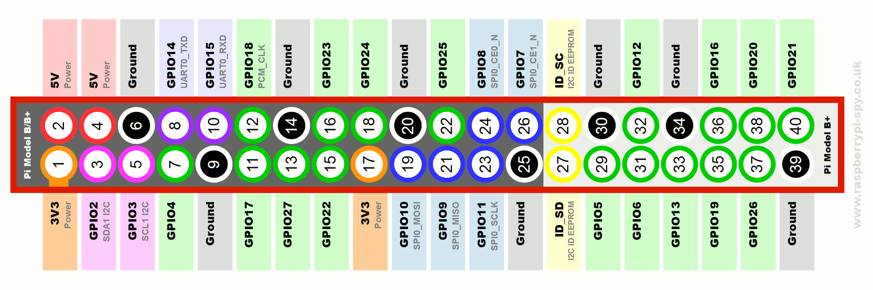
Raspberry Pi
I have better things to do than make a presentation that’s already been made, so we’ll use this one that I found online:
Raspberry Pi Presentation

Slide 3
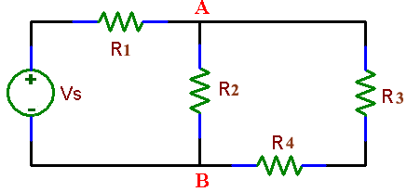
Circuits Introduction
V = IR (Ohm’s law)
V = Voltage - also called ‘potential’
I = Current - the movement of electrons over a wire
R = Resistance - supresses current
Power = IV
Jumpy River Analogy:
We can think of circuits like a water ride at a theme park.
Voltage is the change in altitude
Current is the flow of water
Resistance is the width of the canal you’re floating down.
The analogy isn’t perfect, but it’s good enough for today.

Slide 4
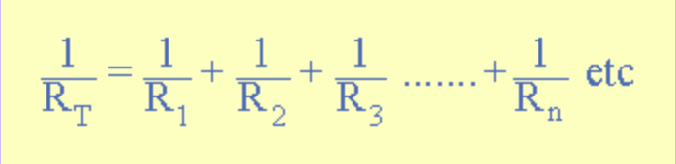
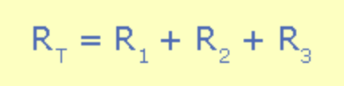
Some Basic principles
Kirchoff’s Voltage Law
The sum of all of the voltage drops in a closed loop has to equal zero.
Branch Current Rule
The sum of the currents going into a node equals zero
Parallel Resistance
Resistors in parallel can be seen as one resistor using the equation
Series Resistance
Resistors in series are can be seen as one resistor using the equation

Slide 5
Voltage Sources
We most often use voltage sources although you can have current sources.
Common types of voltage sources:
DC - voltage remains contant.
AC - voltage changes like a sine wave.
Square waves
Pulses
Sawtooth waves

Slide 6
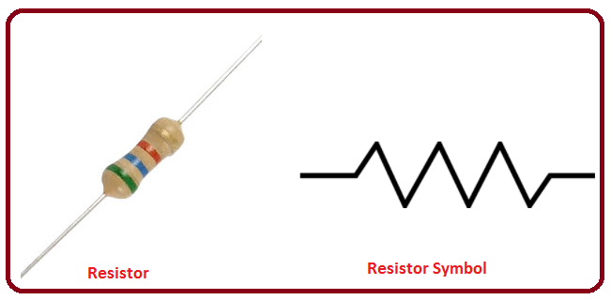


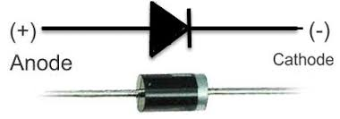

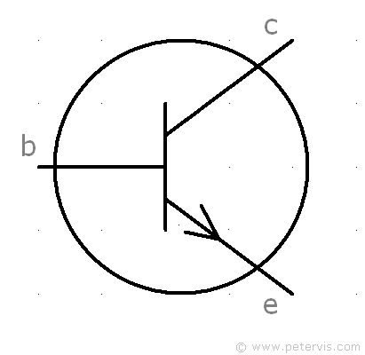

Circuit Components
Resistor
Capacitor
Inductor
Diode
Light Emitting Diode
Transistor
Switch

Slide 7
Digital Passcode Lock Demo
https://github.com/smalbadger/PiLock

